Slide 1
Standing asanas:YANG: these are heat producing and target muscles, blood, skin, and joints, creating length and strength.
These help us find instant connection with the ground. These poses are the bread and butter of Asana practice. These positions sculpt and tone the entire body. Most classes often link several standing postures together to create a heat-inducing flow.

Slide 2
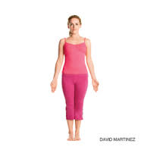
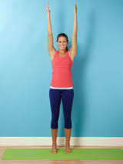
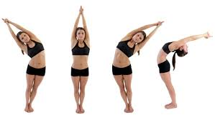
Mountain;(Tadasana) arms overhead, side bend

Slide 3
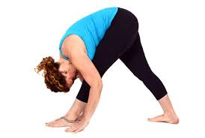
Pyramid-(parsovottanasana)

Slide 4
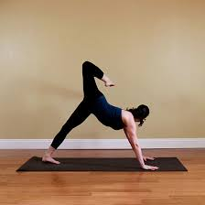
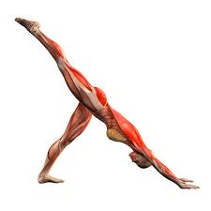
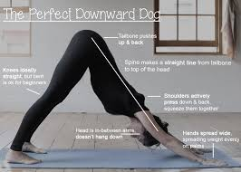
Downward facing dog,(Adho Mukha Svanasana) extended leg, flexed leg (scorpion)

Slide 5
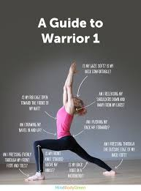
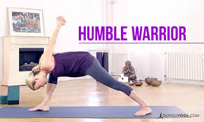
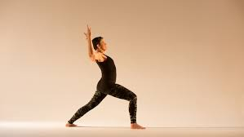
Warrior 1,( Virabhadransana 1) interlaced fold (humble warrior); goalpost arms

Slide 6
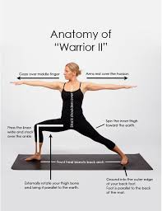
Warrior 2 (Virabhadrasana)

Slide 7

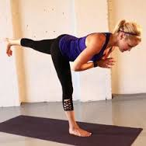
Warrior 3 ( Virabhadrasana 3), hands at heart

Slide 8
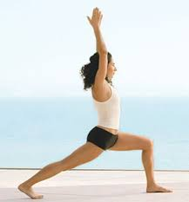
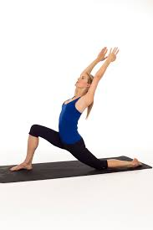
Crescent (Anjaneyasana), lunge

Slide 9
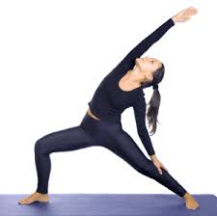
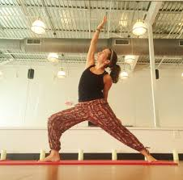
Reverse warrior (Viparita Virabhadrasana), wrapped

Slide 10
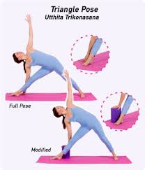
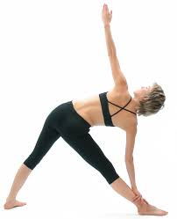
Triangle, (Trikonasana), block, shin

Slide 11
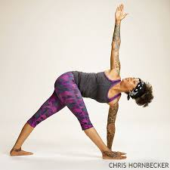
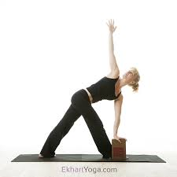
Revolved triangle (Parivrtta Trikonasana), block

Slide 12
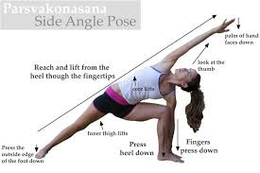
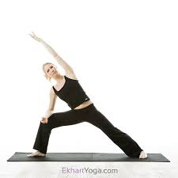
Side angle (Parsvakonasana), forearm

Slide 13
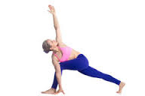
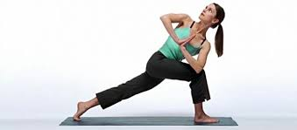
Side angle revolved, palms press

Slide 14
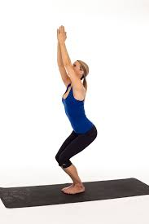
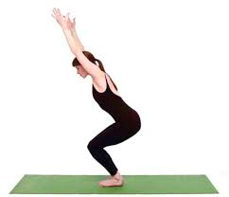
Chair (Utkatasana), palms, thumbs, forearms

Slide 15
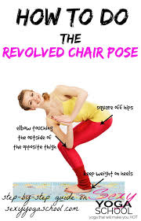
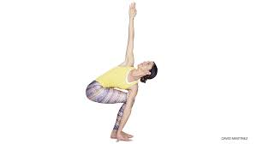
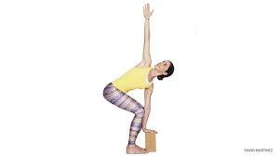
Revolved chair (Parivrtta Utkatasana), arm extended, block

Slide 16
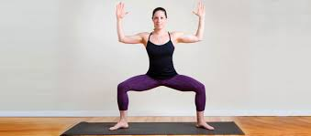
goddess (Utkata konasana)

Slide 17
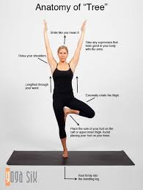
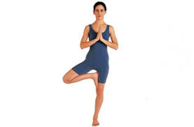
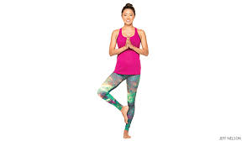
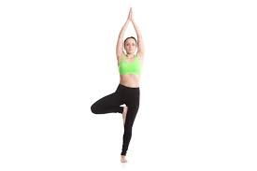
Oak tree( Vrksasana), prayer, palms, modified

Slide 18
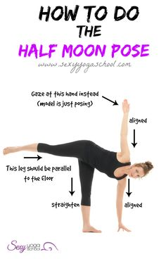
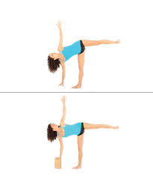
Half moon (Ardha Chandrasana)

Slide 19
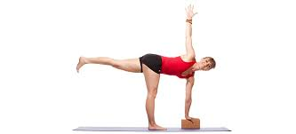
Half moon revolved,( Parivrtta Chandrasana)

Slide 20
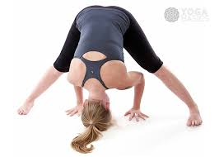
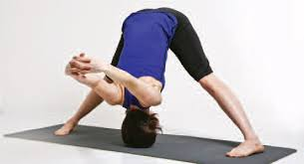
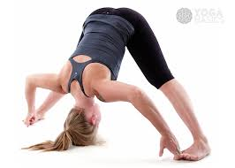
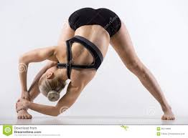
Wide legged forward fold,(Prasarita Padottanasana), interlaced, big toe hook, head to leg

Slide 21
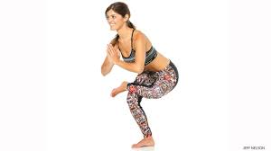
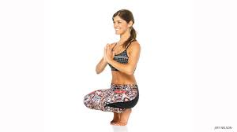
Standing toe balance, on toes

Slide 22
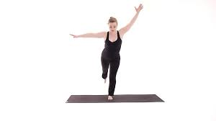
Holy fig

Slide 23
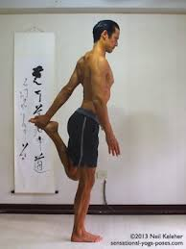
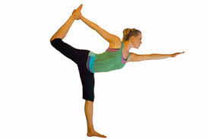
Dancer (Natarajasana), modified

Slide 24
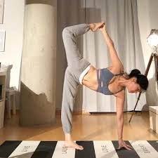
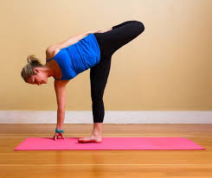
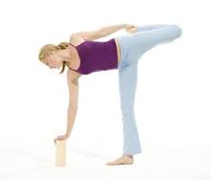
Sugar cane (chopasana), block

Slide 25
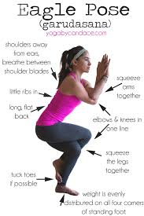


Eagle(Garudasana)wrapped arms

Slide 26




Garland( Malasana),palms, arms forward

Slide 27

Balanced warrior pose

Slide 28
Standing asana routine
Balance practice---OAK R AND L
Warrior 1
Warrior 1 twist (arms abducted)
Triangle
Warrior 2 R----star-------warrior 2 L-------pendulum swing
Crescent front knee (for balance) then kick x4 each side
Triangle
Reverse warrior----side angle for reps
Warrior 3-------into tall crescent R/L

Slide 29
Standing asana #2
Chair
Warrior 1
Dragon
Chaturanga eccentrics x 6
Downdog
Extended leg downdog
Goddess squat
Goddess reps (up/down)
Pendulum x 6
Goddess twist x8

Slide 30
Standing asasna routine: triple downdog
MOUNTAIN START R AND REPEAT WITH L
PYRAMID --------GARLAND
TRIPLE DOWNDOG X 6-----UPDOG
REVERSE WARRIOR FOR REPS
WARRIOR 1 TWISTS
SIDE ANGLE----SIDE ANGLE PALMS PRESS (REVOLVED)
TRIANGLE 1------REVOLVED
TRIPLE DOWNDOG X 6----UPDOG
HALF MOON------SUGAR CANE
GODDESS-----BALANCED WARRIOR

Slide 31
Standing asana and strength routine:
Triangle R/L repeat 1-5
Triangle revolved R/L 10 warrior lifts R/L
Twist in standing 10 mini squat hops
Forward split pyramid repeat 1-5
Pendulum
10 sumo squats STRAPS
Warrior 1 forward/backward sweep
Repeat 1-5
10 front lunge up/downs R/L
Goddess

Slide 32
Standing asana and hip opener
TRIANGLE 1
REVOLVED TRIANGLE
TWIST IN STANDING
PYRAMID TWIST
HERO----PENDULUM
SIDE ANGLE (FOREARM PRESS)
SIDE ANGLE REVOLVED
GATE POSE
TRI-PLANAR (FRONT ONLY X4)
SINGLE PIGEON
REPEAT 3 X
1ST TIME: 2 BREATHS
2ND TIME: 1.5 BREATHS
3RD TIME: 1 BREATH

Slide 33
My Goddess sequence
Goddess
Goddess shoulder rotation
Pyramid
Downdog w/repeated ext. leg x 4
Downdog—front lunge knee down (runners lunge forward rock)
Front high lunge knee off mat with rock
Front high lunge with arm sweep back/forward into crescent
Power down fists—power arms at sides—drop into crescent lunge
Warrior 1 twists---straight arm twist
Triangle 1
Goddess/pendulum swing

Slide 34
Standing asana performance assessment: proprioceptive points
Pyramid:
Both legs straight; stagger stance
Chest to thigh
Hands on floor or blocks

Slide 35
Downdog
Feet flat
Head extension of spine or cervical flexion
Arms and legs straight
If you cannot achieve these use 2 blocks

Slide 36
Warrior 1; humble, and goalpost
Front leg vertical to mat, bent 45-90 degrees whatever you can manage
Back foot flat and everted
Shoulders stacked over hips
Chest upward (not collapsed)
Arms overhead
Palms face

Slide 37
Warrior 2
Arms straight, abducted and parallel to floor
If in right warrior 2, leg is at 90 degrees or as close as you can manage
Shoulders stacked over hips
Left leg is straight, foot everted
Gaze over horizon (top of arms)

Slide 38
Warrior 3
Back leg parallel in height to floor
Back leg in line with torso and head
Neutral gaze
Arms in line with torso or palms face
Front leg straight (optimal); sufficient if slightly bent

Slide 39
Crescent (not lunge)
Palms face
Front leg at 90 degrees or close
Ball of back foot touches mat only
Shoulders stacked over hips
Arms overhead

Slide 40
Reverse warrior
Same position as warrior 2
Back arm rests on leg outside of knee
Front arm reaches past head straightened (close to ear)
Gaze upward if manageable

Slide 41
Triangle and revolved
Both front and back legs straight
Back foot in eversion
Arms stacked straight over each other
Revolved (arm positioning switched)

Slide 42
Side angle and revolved
Imaginary straight line from foot of extended leg to hand on arm of same side of body
Opposite leg at 90 degrees or close
Opposite arm straight touching floor either in front or back of flexed leg
Revolved involves opposite arm positioning (hand on floor either in front or back of flexed leg)

Slide 43
goddess
Legs flexed as close to 90 degrees as possible externally rotated
Arms abducted, elbows in flexion; shoulder joint externally rotated
Chest upright

Slide 44
oak
Standing leg is straight
Opposite foot against opposite leg any height (pressing inward )
Shoulders over hips
Shoulders back and down
Core and glutes contracted
Hands/arms wherever manageable

Slide 45
Half moon modified
Arms stacked straight over each other
Front knee on mat (or standing leg is straight)
Back leg parallel to floor and straight (either modified or standing)

Slide 46
Wide-legged forward fold
Legs in sumo stance and straight
Hands on floor or wherever manageable
Hips in flexion
Head hangs toward mat

Slide 47
chair
Hips toward back body
Knees in alignment (width same as feet)
Chest upright
Arms parallel at any height in front body or overhead
Gaze neutral

Slide 48
Revolved chair
Hips toward back body
Knees in alignment
Thoracic rotation
Palms face
Opposite elbow is resting on outside of opposite knee

Slide 49
Standing toe balance
Front leg bent at 90 or so degrees
Leg off floor lateral ankle rests on opposite knee/lower thigh
Hips toward back body (flexion)
Chest upright
Palms face; elbows in flexion
Bodyweight through middle of foot on floor

Slide 50
Holy fig
Front hip in flexion
Chest forward
Back arm out in abduction
Front arm in flexion

Slide 51
Dancer or standing quad
Same position as holy fig
Back arm parallel with body
Hand on top of foot
Contracting back quad muscle

Slide 52
garland
Sumo stance
Global flexion
Chest upright
Hips externally rotated
Palms face, elbow flexion; arms abduced
Feet flat on floor (optimal); sufficient to be on balls of feet (should strive toward flat feet on floor)

Slide 53
Balanced warrior
Hips toward backbody
Bodyweight centered through midline
Front leg at 90 degrees or close
Opposite leg as straight as possible
Feet where manageable

Slide 54
Standing asana performance assessment #1—20 points: here’s the breakdown:
DOWNDOG –2 POINTS
WARRIOR 1; HUMBLE & GOALPOST –3 POINTS
WARRIOR 2 —1 POINT
CRESCENT— 1 POINT
REVERSE WARRIOR— 1 POINT
SIDE ANGLE & REVOLVED— 2 POINTS
GODDESS— 1 POINT
OAK -1POINT
CHAIR & REVOLVED— 2 POINTS
WIDE LEGGED FORWARD FOLD— 1 POINT
½ MOON MODIFIED – 1POINT
TRIANGE 1 & REVOLVED— 2 POINTS
HOLY FIG— 1 POINT
BALANCED WARRIOR – 1 POINT = 20 TOTAL POINTS

